Slide 1

Logistic Regression on MNIST from Scratch

Slide 2
Reference
Youtube
Code

Slide 3
Worm Up

Slide 4
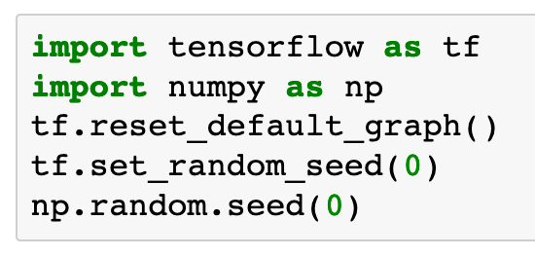

Slide 5
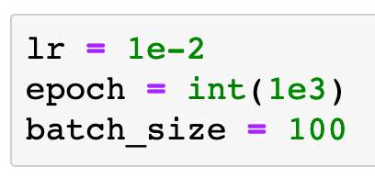

Slide 6
Data

Slide 7
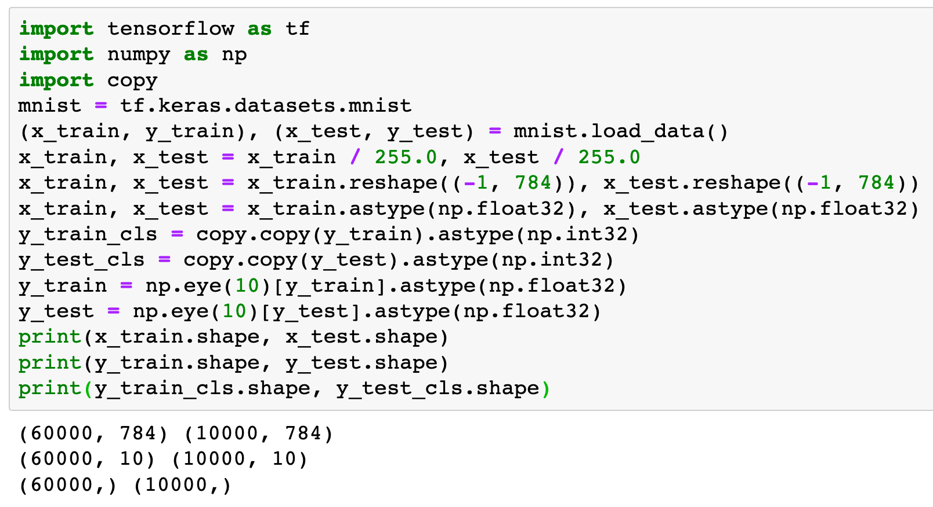

Slide 8
Graph

Slide 9
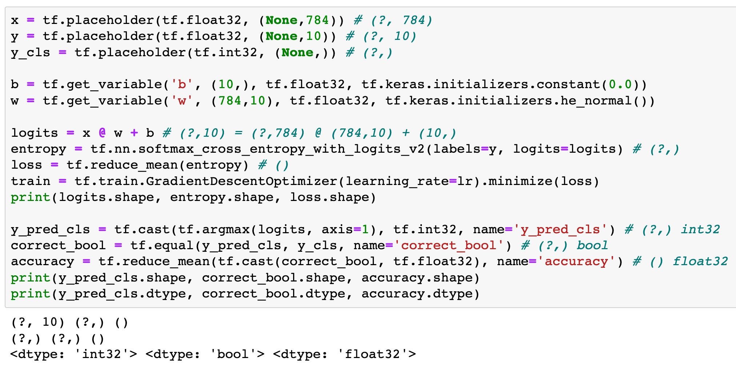

Slide 10
Session

Slide 11
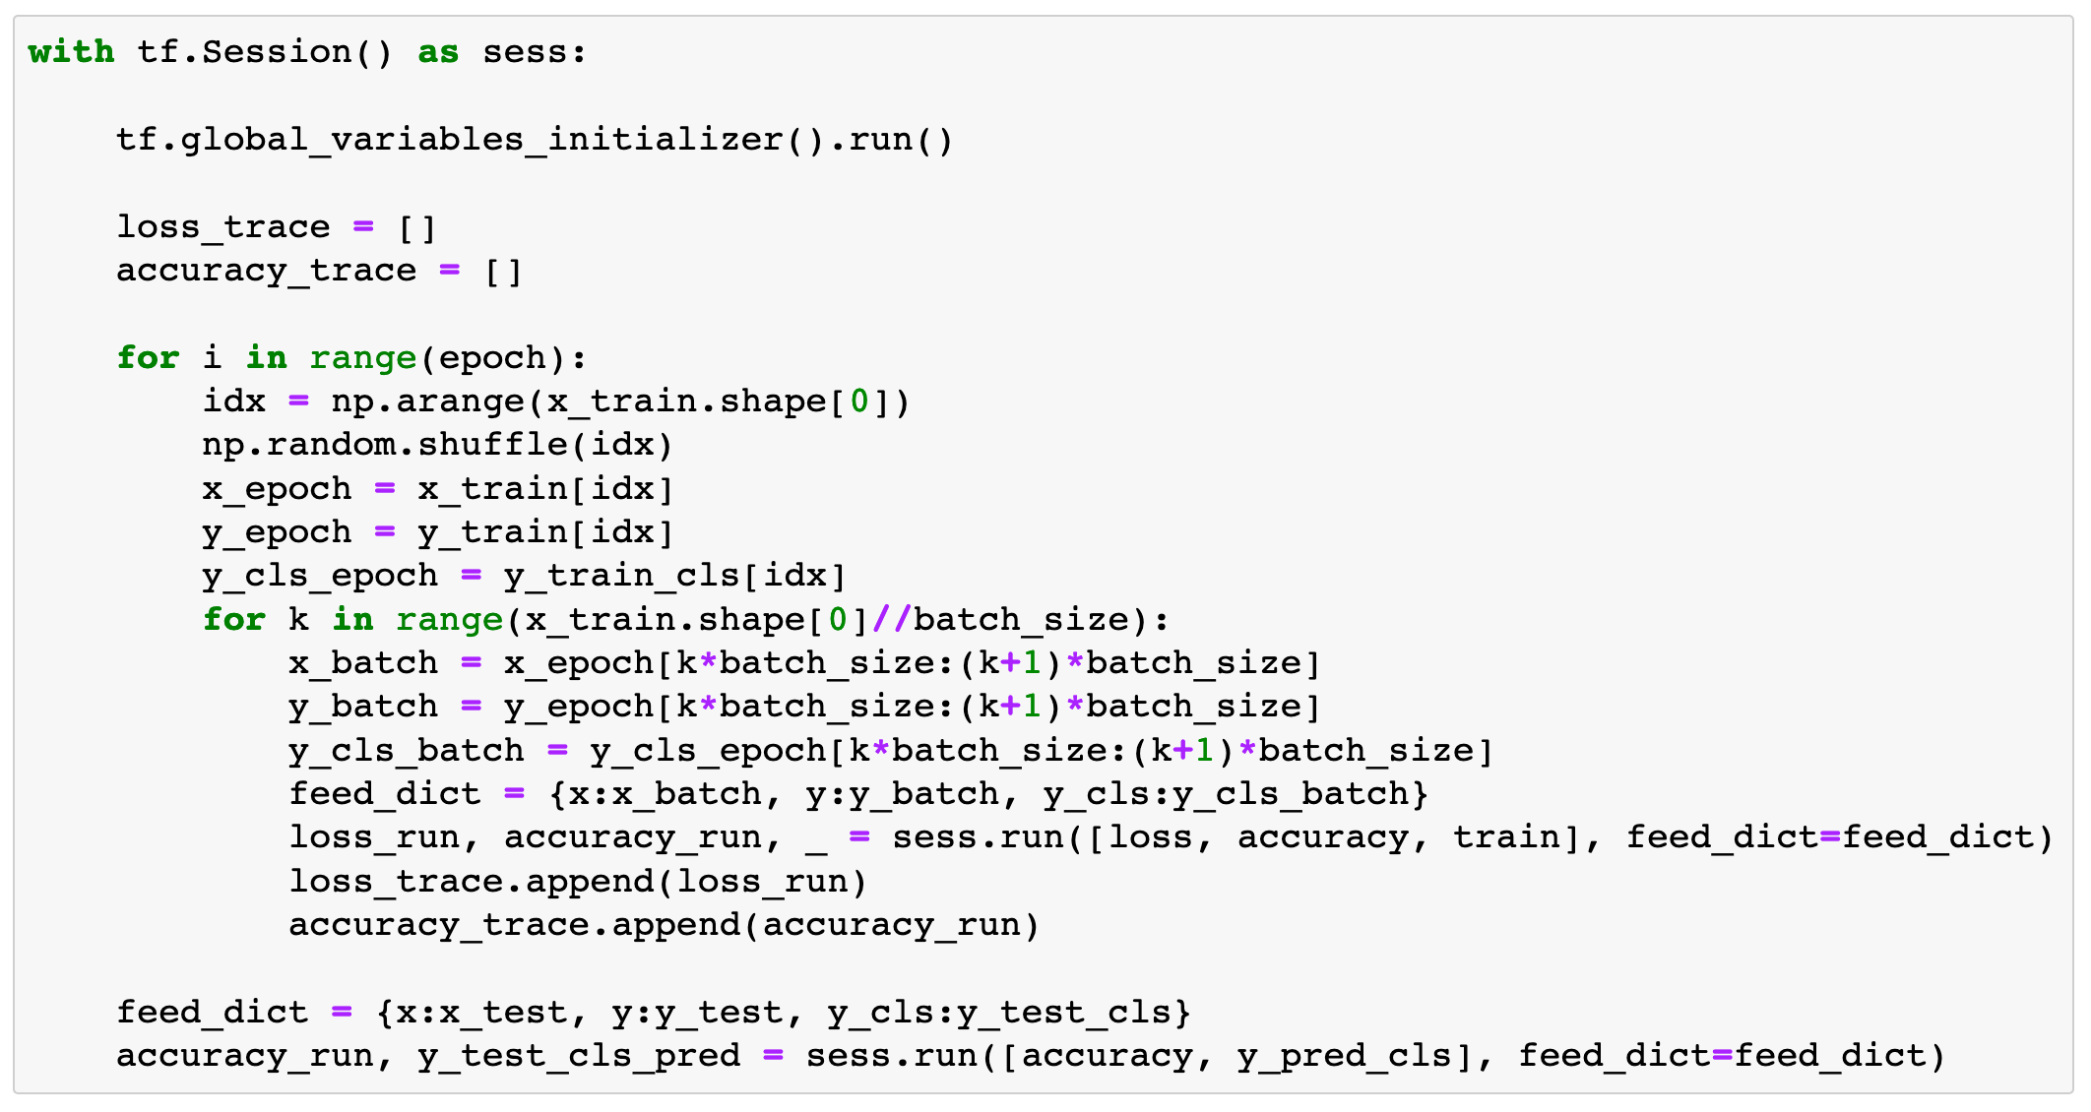

Slide 12
Report Result

Slide 13
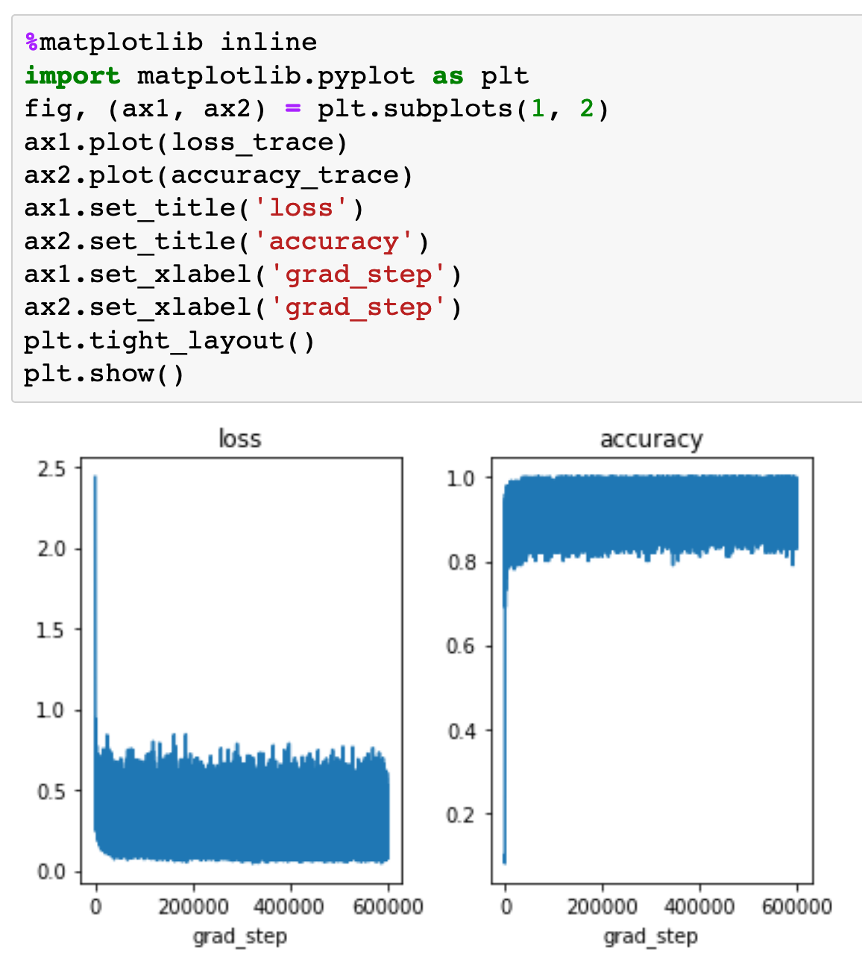

Slide 14
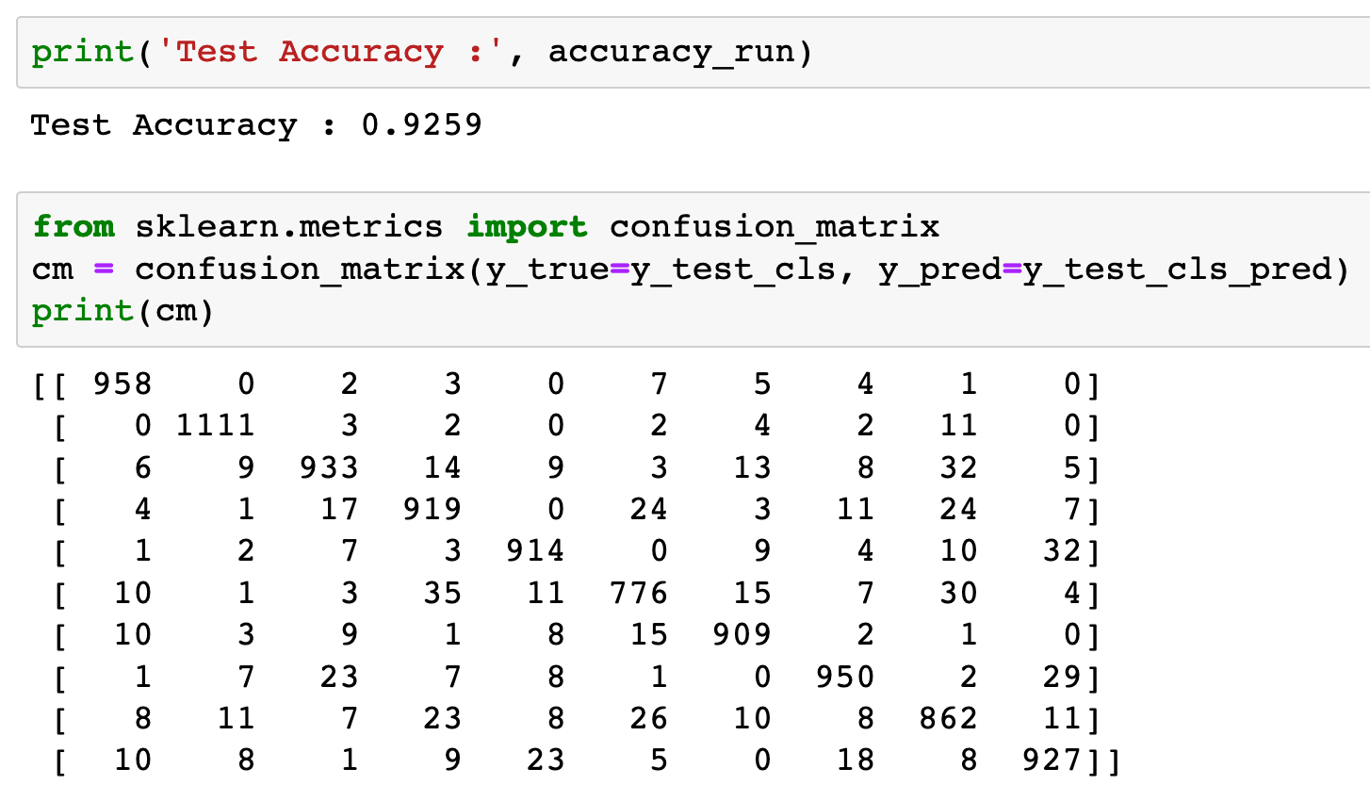


Slide 16
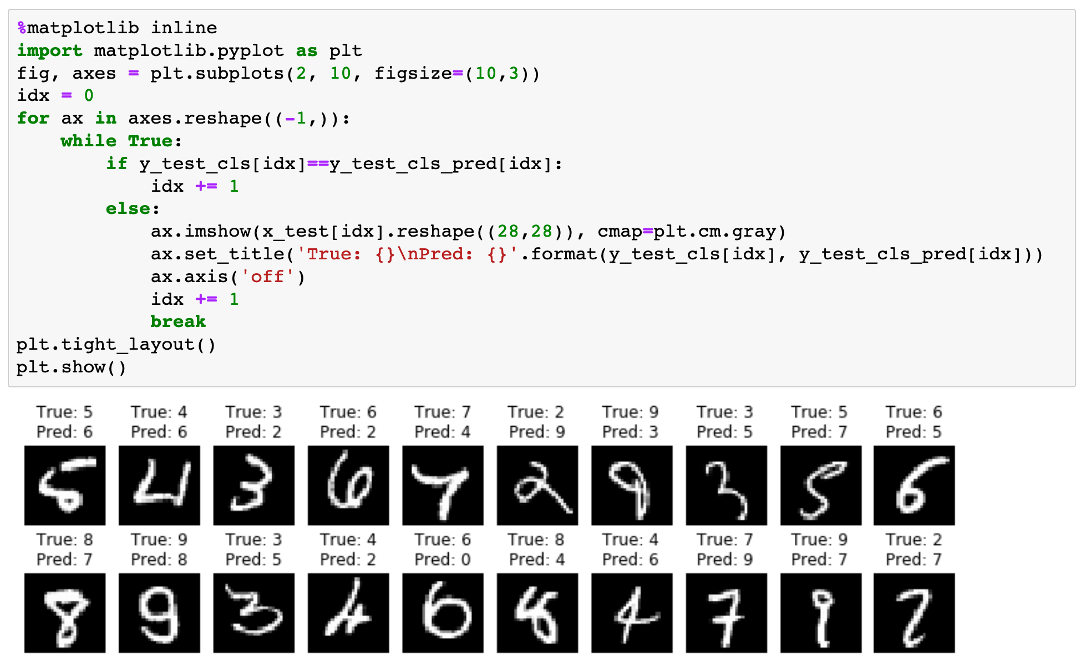

Slide 17
Now
Let’s Play with Code

